Slide 1
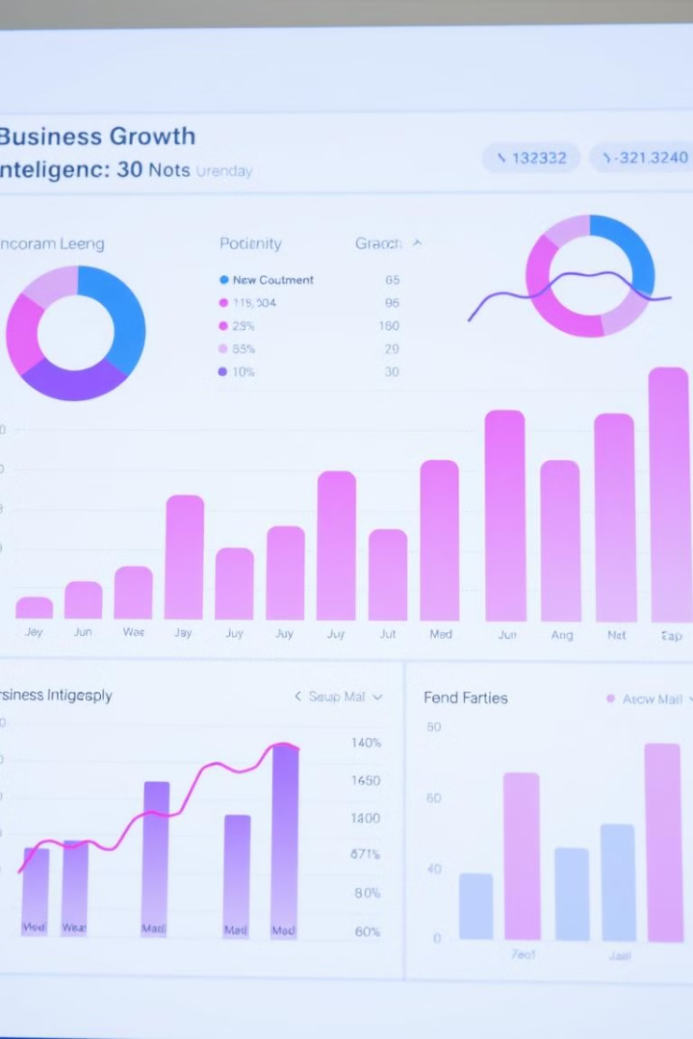

Customer Segmentation Analysis Using Power BI
Unlocking actionable insights from shopping behavior.
by Parney Nagacharanya

Slide 2
What is Power BI and How It Helps?
Power BI
Capabilities
Power BI is a business analytics tool by Microsoft that allows users to visualize data, create interactive reports and dashboards, and share insights. It integrates with various data sources, helping organizations make data-driven decisions efficiently.
Actionable insights from raw data
Interactive dashboards and reports
Unified data from multiple sources

Slide 3
Project Journey
Problem Identification
1
Classify customers and optimize strategies
2
Data Collection
Customer demographics, purchase history, transaction details
Data Processing
3
Clean, transform, and structure data
4
Exploratory Data Analysis (EDA)
Identify patterns and customer clusters
Dashboard Development
5
Interactive visuals and key insights

Slide 4
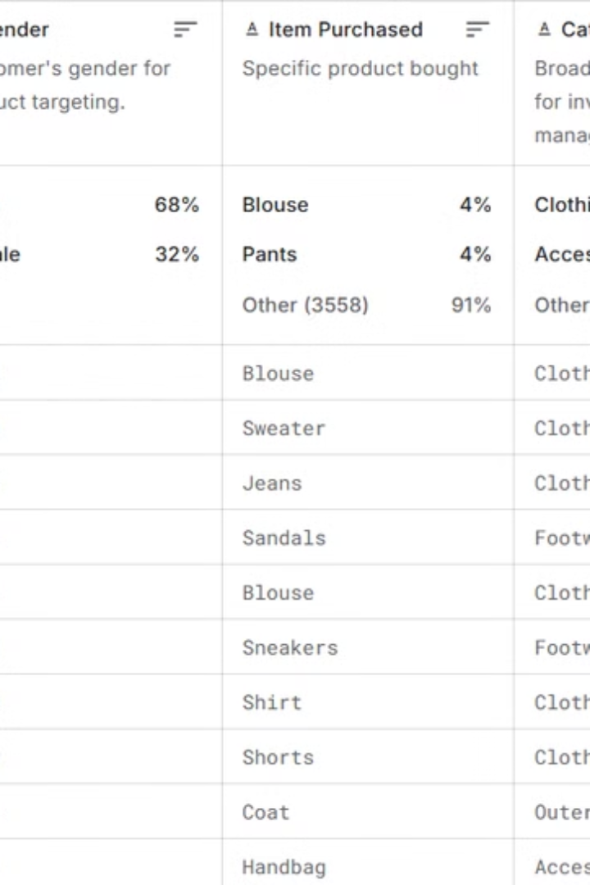
Dataset Details
Shopping Trends Dataset
Dataset Content
Customer demographics(Age,gender,location)
Acquired from Kaggle[https://www.kaggle.com/datasets/zeesolver/consumer-behavior-and-shopping-habits-dataset]
Purchase history(frequency of purchase,products,transaction amount)
Transactional and behavioral data(Payment methods,shopping preferences

Slide 5
Building the Dashboard: A Step-by-Step Approach
Data Cleaning
1
Remove duplicates, handle missing values, and standardize formats
Data Engineering
2
Create calculated columns and group data for segmentation
Exploratory Data Analysis (EDA)
3
Identify trends and correlations using statistical analysis
Visualization Creation
4
Design charts, heatmaps, and graphs in Power BI
Insights Extraction
5
Formulate recommendations from data visualizations

Slide 6
Preprocessing Steps and DAX Functions
Preprocessing Steps
DAX Functions Used
Remove duplicates and outliers
SUM and AVERAGE for aggregated metrics
Standardize date formats
CALCULATE for filtering and computing totals
Create columns for calculated metrics
RANKX for ranking customer value
IF and SWITCH for conditional logic

Slide 7
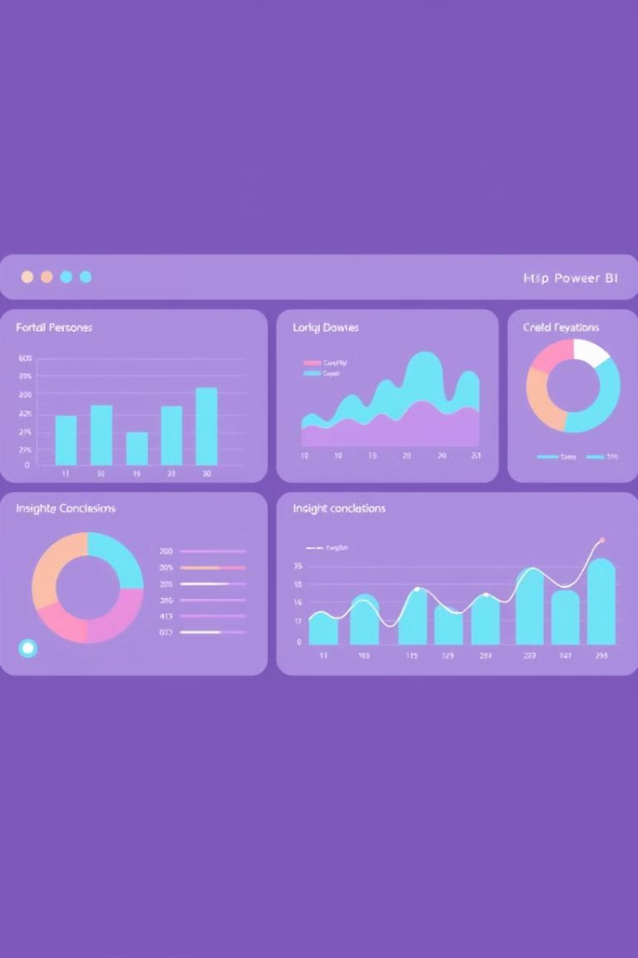



Visualization: Transforming Data into Insights
Clarity
1
Complex data into visual elements
Highlight Trends
2
Trends, outliers, and patterns
Actionable Insights
3
Better decision-making

Slide 8
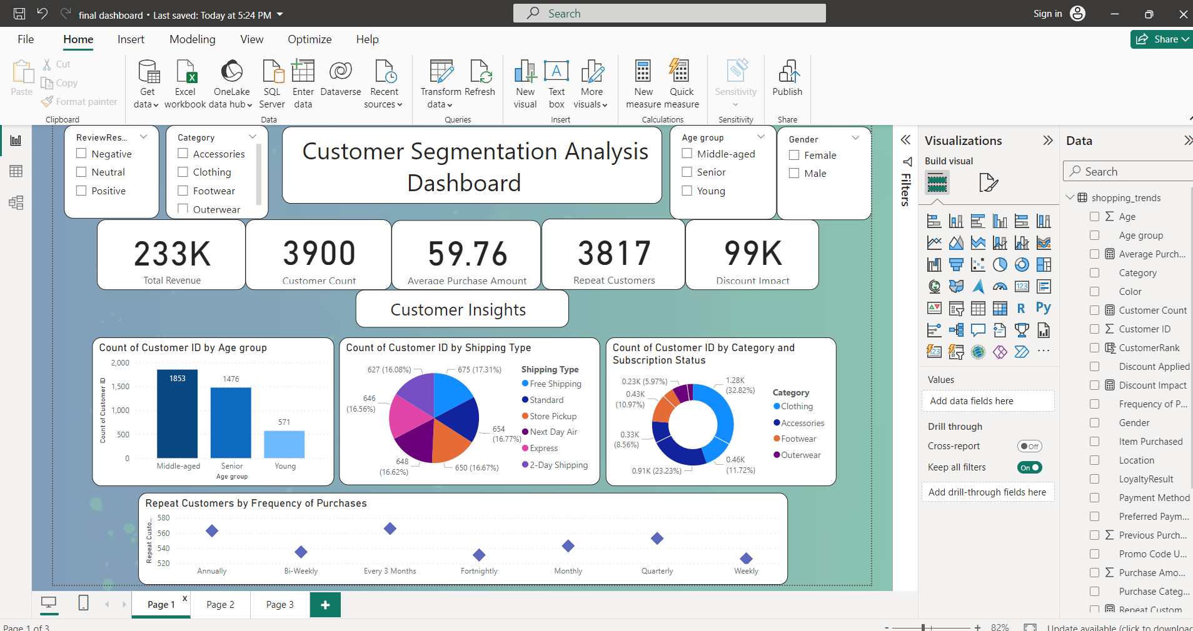
Dashboard

Slide 9
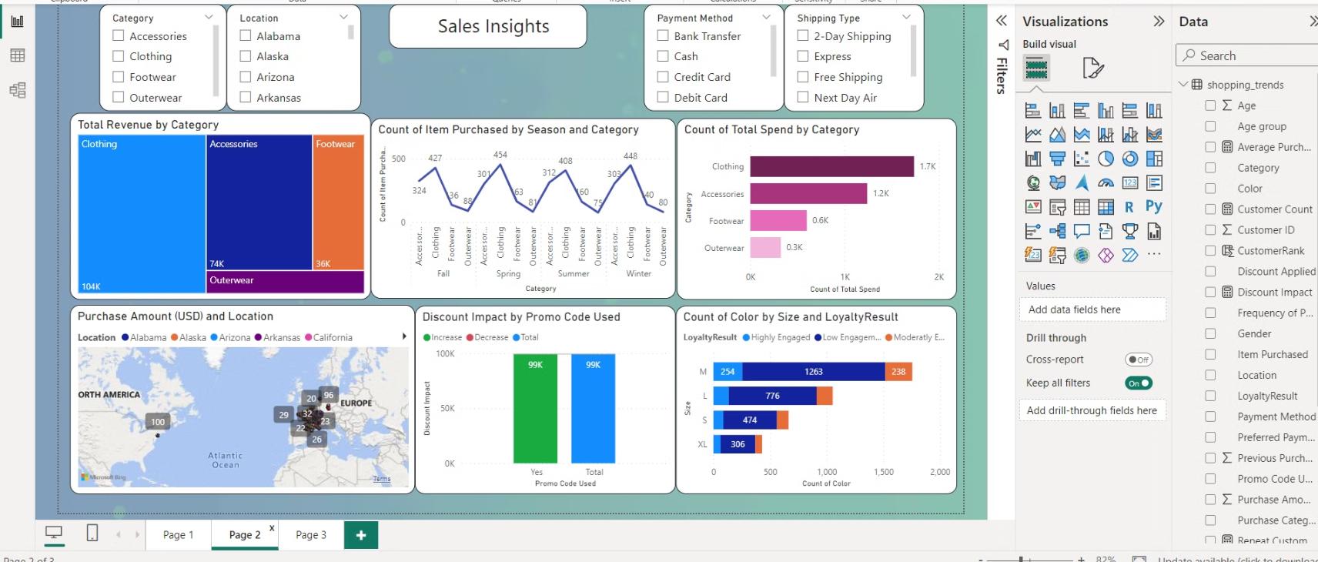
Dashboard

Slide 10
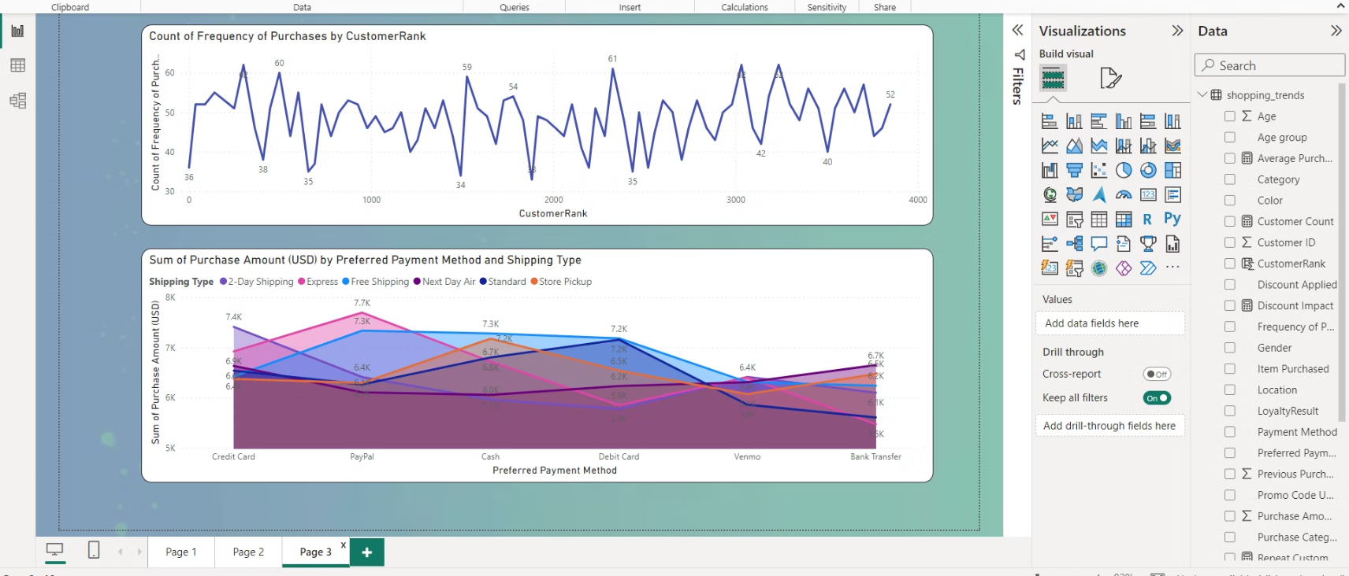
Dashboard

Slide 11

Key Insights
1
Loyal Customer Value
2
Seasonal Trends
Seasonal trends impact shopping behavior
Loyal customers contribute significantly to revenue
3
Promotion Influence
Promotions and discounts influence demographics

Slide 12



Conclusion
Data-Driven Insights
1
Simplified analysis with Power BI
Actionable Strategies
2
Enhanced customer engagement
Future Scope
3
Incorporate more datasets and advanced techniques

Slide 13

Thank You!

